Slide 1

TELECOM CHURN CASE STUDY

Slide 2

INTRODUCTION
Churn is a problem for telecom companies because it is more expensive to acquire more customers than to keep your existing one from leaving
Churn Prediction is one of the most popular big data use cases in business.

Slide 3
PROBLEM STATEMENT
In the telecom industry, customers are able to choose from multiple service providers and actively switch from one operator to another. In this highly competitive market, the telecommunication industry experiences an average of 15-20% of annual churn rate.
To reduce customer churn, telecom companies needs to predicts which customers are at high risk of churn.
In this project u will analyse customer – level data of a leading telecom firm, build predictive models to identify customers at high risk of churn and identify the main indicator of churn.

Slide 4
UNDERSTANDING AND DEFINING CHURN
There are 2 main modes of payment in telecom industry. i.e, Postpaid and
Prepaid.
In the postpaid model, when customer wants to switch to another operator, they usually inform the existing operator to terminate the services and you directly know that this is an instance of churn.
However in prepaid model, customer who want to switch to another network can simply stop using services without any notice and it is hard to know whether someone has actually churned or is simply not using the service temporarily.
Thus, churn prediction is usually more critical for prepaid customers and the term ‘churn’ should be defined carefully. Also, prepaid is most common in India and Southeast Asia, while postpaid is common in Europe and North America.
This project is based on Indian and Southeast Asian market.

Slide 5

DEFINITIONS OF CHURN
Revenue based churn : Customers who have not utilised any revenue generating facilities such as mobile internet, outgoing calls, SMS etc. over a given period of time. One could also use aggregate metrics
such as ‘customers who have generated less than INR 4 per month in total/average/median revenue.
Usage-based churn : Customer who have not done any usage, either incoming or outgoing – in terms of calls, internet etc. over a period of time.
In this project you will use Usage-based definition to define churn.

Slide 6

UNDERSTANDING THE BUSINESS OBJECTIVE AND THE DATA
The business objective is to predict the churn in the last month using the data from the first three months. To do this task well, understanding the typical customer behaviour during churn will be helpful.

Slide 7

UNDERSTANDING CUSTOMER BEHAVIOUR DURING CHURN
In churn prediction, we assume that there are 3 phases of customer life cycle:
The Good Phase
The Action Phase
The Churn Phase
In this case, since you are working over a four month window, the first 2 months are The Good Phase, the third month is The Action Phase and the fourth month is The Churn Phase.

Slide 8
METHODOLOGY
Data cleaning and data manipulation.
Check and handle duplicate data.
Check and handle NA values and missing values.
Drop columns, if it contains large amount of missing values and not useful for the analysis.
Imputation of the values, if necessary.
Check and handle outliers in data.
EDA
Univariate data analysis: value count, distribution of variable etc.
Bivariate data analysis: correlation coefficients and pattern between the variables etc. ▪Feature Scaling & Dummy Variables and encoding of the data.
Classification technique: logistic regression used for the model making and prediction. ▪Validation of the model.
Model presentation. ▪Conclusions and recommendation.

Slide 9
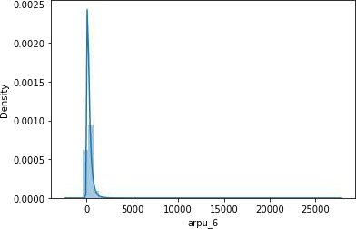
EXPLORATORY DATA ANALYSIS

Slide 10
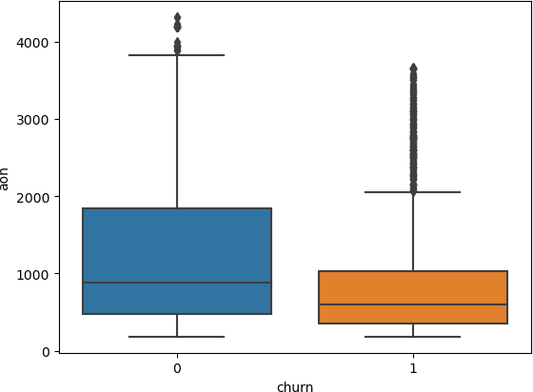
Plotting boxplot

Slide 11
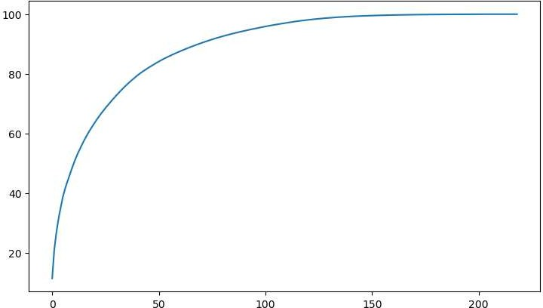
ROC curve

Slide 12
BUSINESS RECOMMENDATIONS
Target the customers, whose minutes of usage of the incoming local calls and outgoing ISD calls are less in the action phase (mostly in the month of August).
Also, the customers having value based cost in the action phase increased are more likely to churn than the other customers. Hence, these customers may be a good target to provide offer.
Customers, whose monthly 3G recharge in August is more, are likely to be
churned.
Customers having decreasing STD incoming minutes of usage for operators T to
fixed lines of T for the month of August are more likely to churn.
Customers decreasing monthly 2g usage for August are most probable to churn.
Customers having decreasing incoming minutes of usage for operators T to fixed
lines of T for August are more likely to churn.

Slide 13

THANK YOU

